Slide 1


Slide 2

What is IMDb?
What are we doing with it?

Slide 3
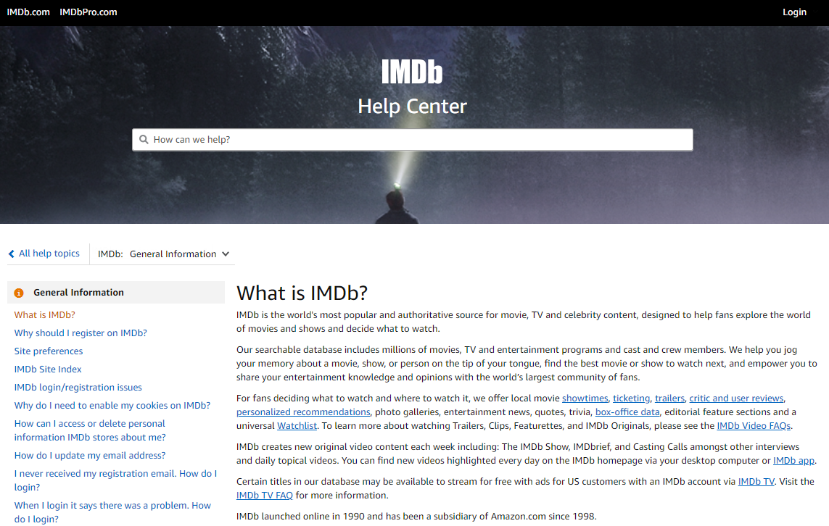
Source: https://help.imdb.com/article/imdb/general-information/what-is-imdb/G836CY29Z4SGNMK5?ref_=helpsect_cons_1_1#

Slide 4
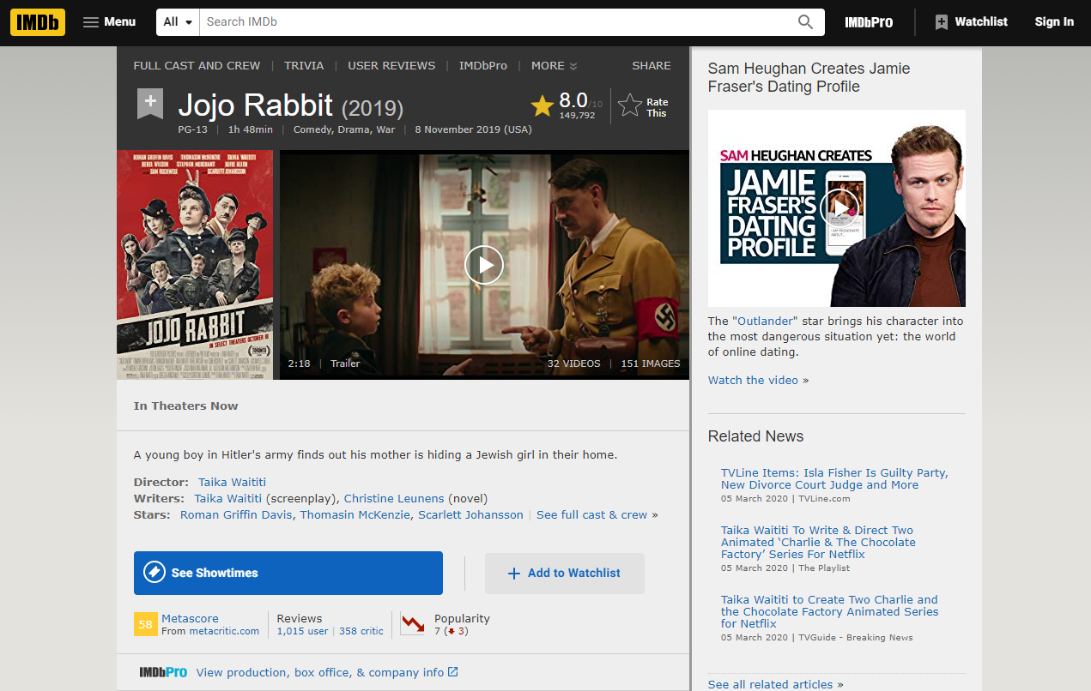
Information of the base
Source: https://www.imdb.com/title/tt2584384/

Slide 5

Quick Glossary
What exactly are we talking about?

Slide 6

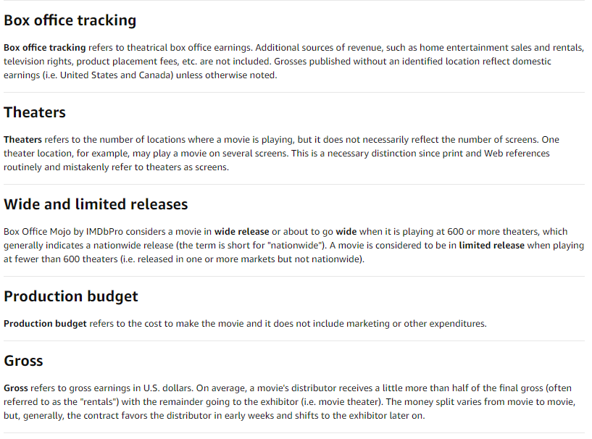
This is just for you to know where the gross comes from. They track the box office earnings and sum them to generate the gross income.
For the purpose of this analysis we are going to assume that the budget is the whole expense, we want to know it the movie made it or break it
For Gross Income, we considered all the data instead of just half, since we don’t know how much of that half is for the distributor and in simple numbers we wanted to know if the movie ‘made’ money or loss it.
Source: https://help.imdb.com/article/imdbpro/industry-research/box-office-by-imdbpro-glossary/GN8HA87MT4597FSW?ref_=helpart_nav_9#

Slide 7
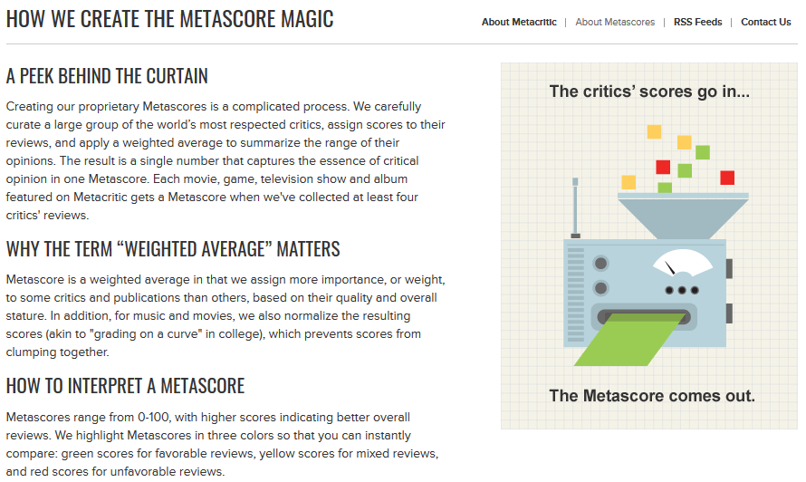
… in more simple words, the metascore is a normalize weighted average of the critics score (at least 4 critics to generate the metascore)
Source: https://www.metacritic.com/about-metascores

Slide 8

Who are tougher reviewers with their ratings, the viewers or the critics?
Tough questions will be decided

Slide 9

But first…what is a rating?
Viewer Ratings
“Weighted Average Vote” of all viewer ratings for a specific movie
Critic Ratings
Weighted score based on IMDb’s “Metascore” methodology

Slide 10
Ratings
User
Critics (Metascore in glossary)
IMDb registered users can cast a vote (range from 1 to 10).
Individual votes are aggregated and summarized as a single IMDb rating.
There is only one vote per title per user.
IMDB assigns more importance, to some critics and publications, based on quality and overall stature.
A movie gets a Metascore when at least four critics review that movie.
Range from 0-100.
IMDB normalizes the resulting scores (akin to "grading on a curve" in college), which prevents scores from clumping together.

Slide 11
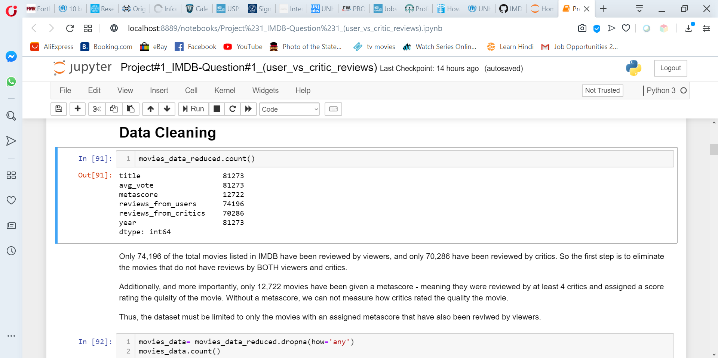
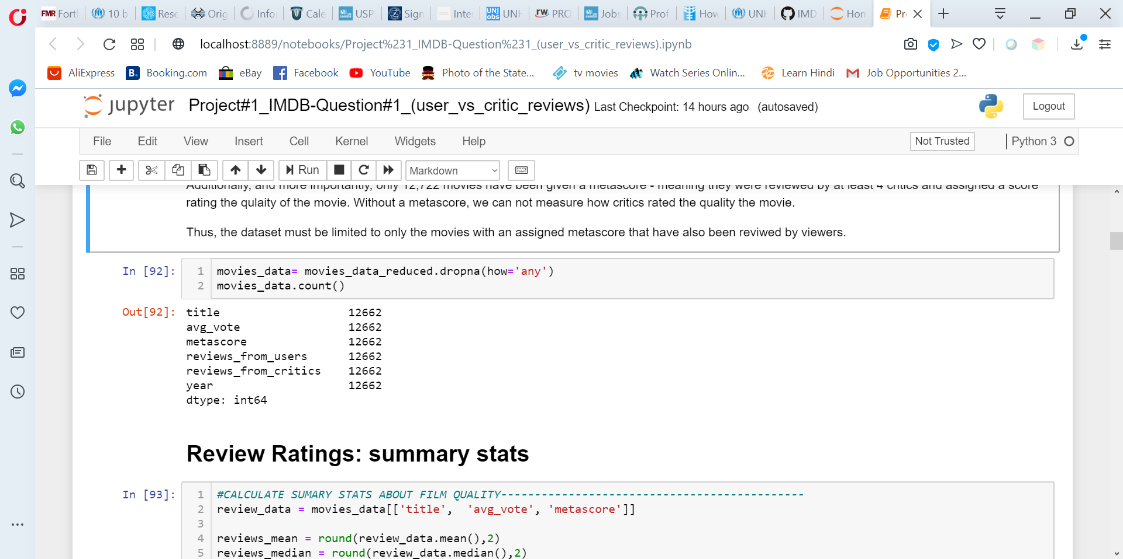
Data Cleaning
Only 74,196 of the total movies listed in IMDB have been reviewed by viewers.
Only 70,286 have been reviewed by critics.
More importantly, only 12,722 movies have been given a metascore.

Slide 12
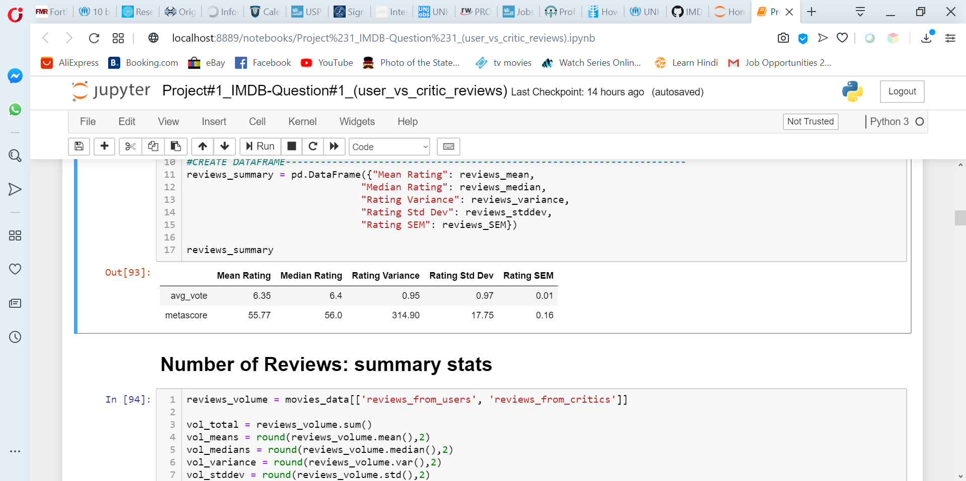
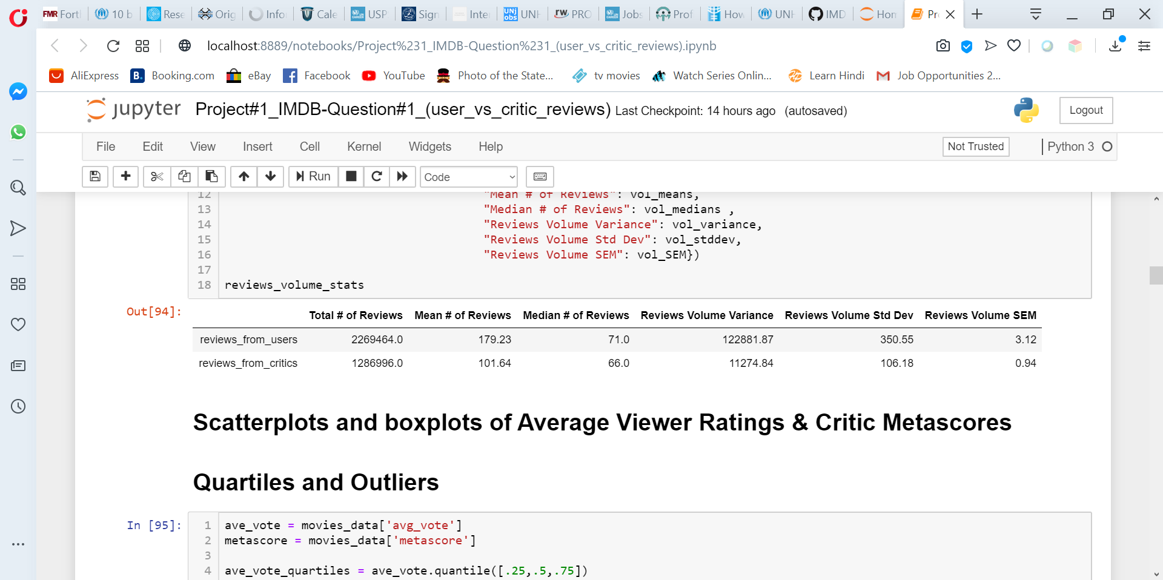
# of Reviews: Greater numbers of overall user reviews than critic reviews, but more consistency in the number of critic reviews of any given movie received vs. the number of user reviews each movie received.
Quality Ratings: More variability in the quality ratings given to movies by critics than by users → there was more consistency among what the viewers thought of the quality of the movie than what the critics thought.

Slide 13
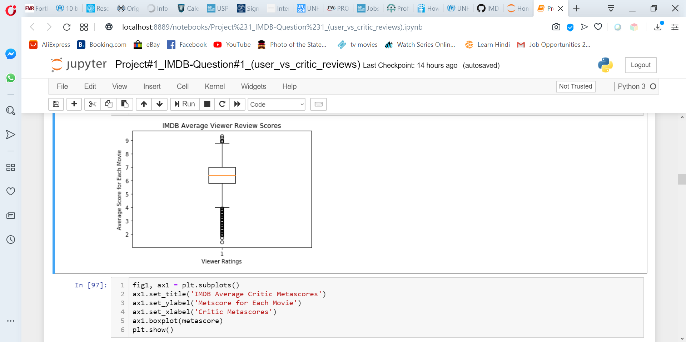
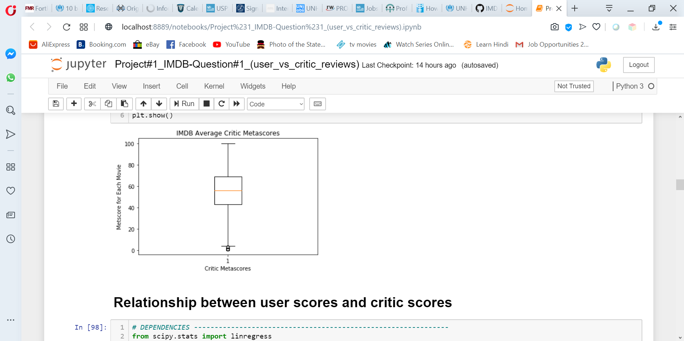
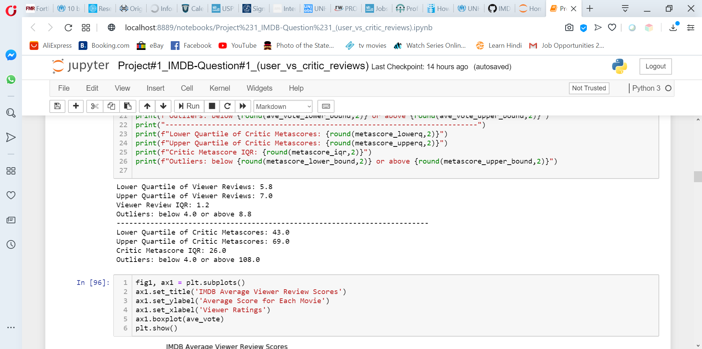
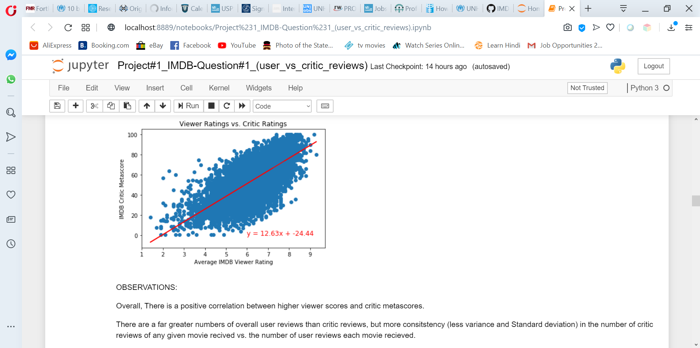

Slide 14
Viewers vs. Critics: Summary
Overall, there is a positive correlation between higher viewer scores and critic metascores.
With the metascore methodology applied by IMDB, critic metascores are already normalized (i.e. adjusted to a normal curve).
Viewer ratings are scaled from 1-10, metascores are scaled 1-100
Not be directly comparable without additional statistical analysis.
If we compare ave metascore relative to its range (1-100) to the ave voter score relative to its range (1-10), viewers do seem to rate movies overall slightly more favorably than critics.

Slide 15
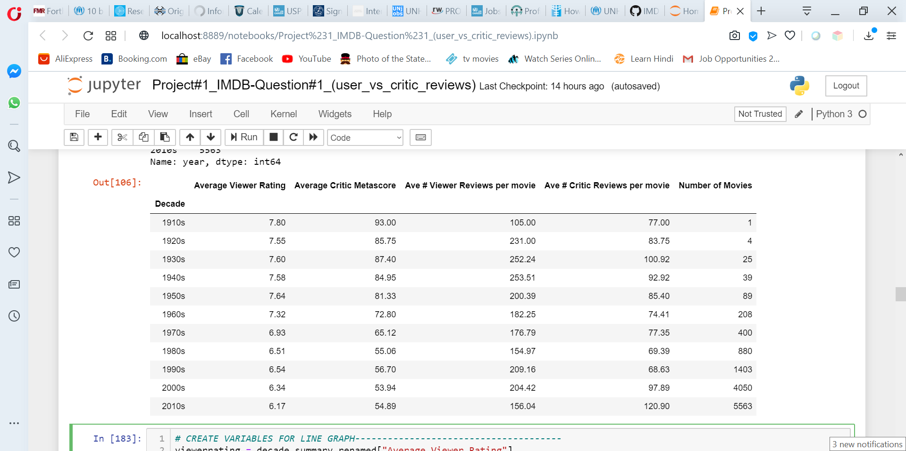
Viewer Ratings by film production year

Slide 16
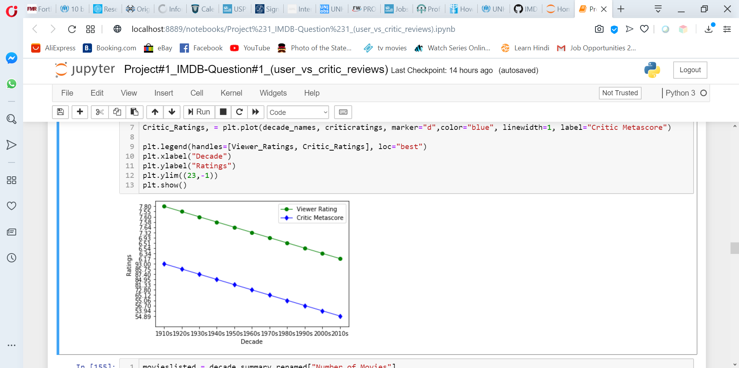
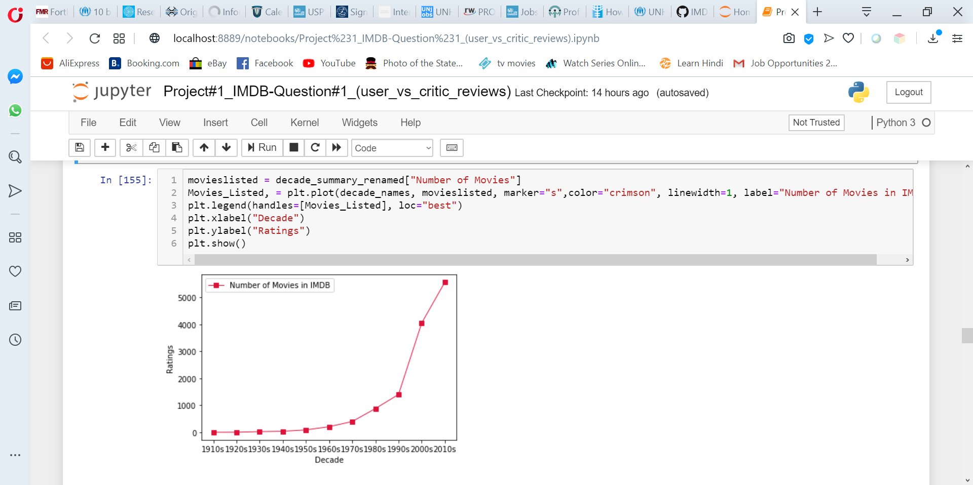
Both viewers and critics rated movies from 1960s and earlier higher.
A majority of the movies in IMDB were made in the 1970s and afterwards.
It could be that the better the quality of movies made before 1970, the more likely it is to be listed and reviewed on IMDB.

Slide 17
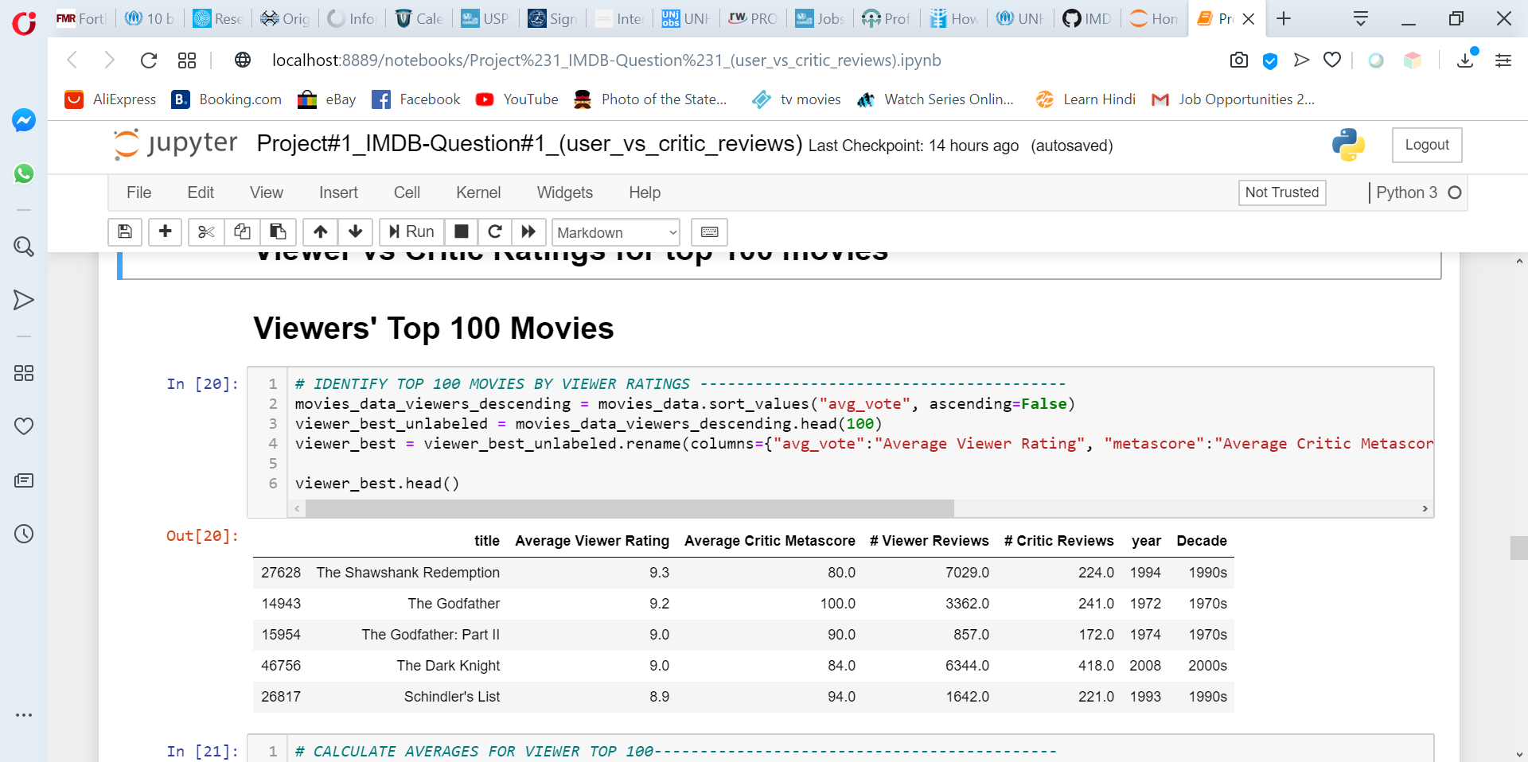
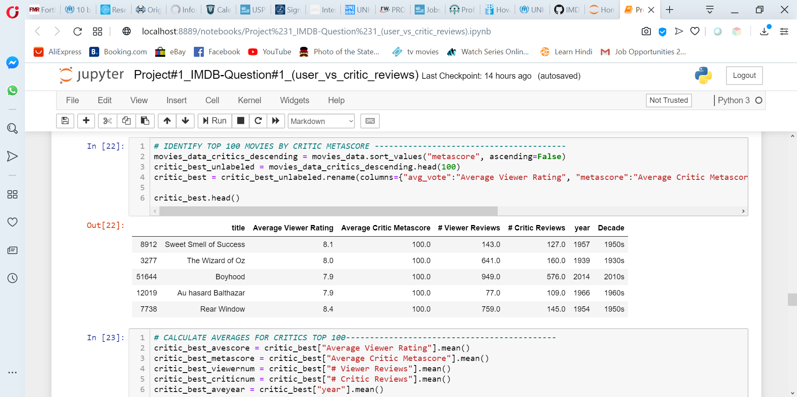
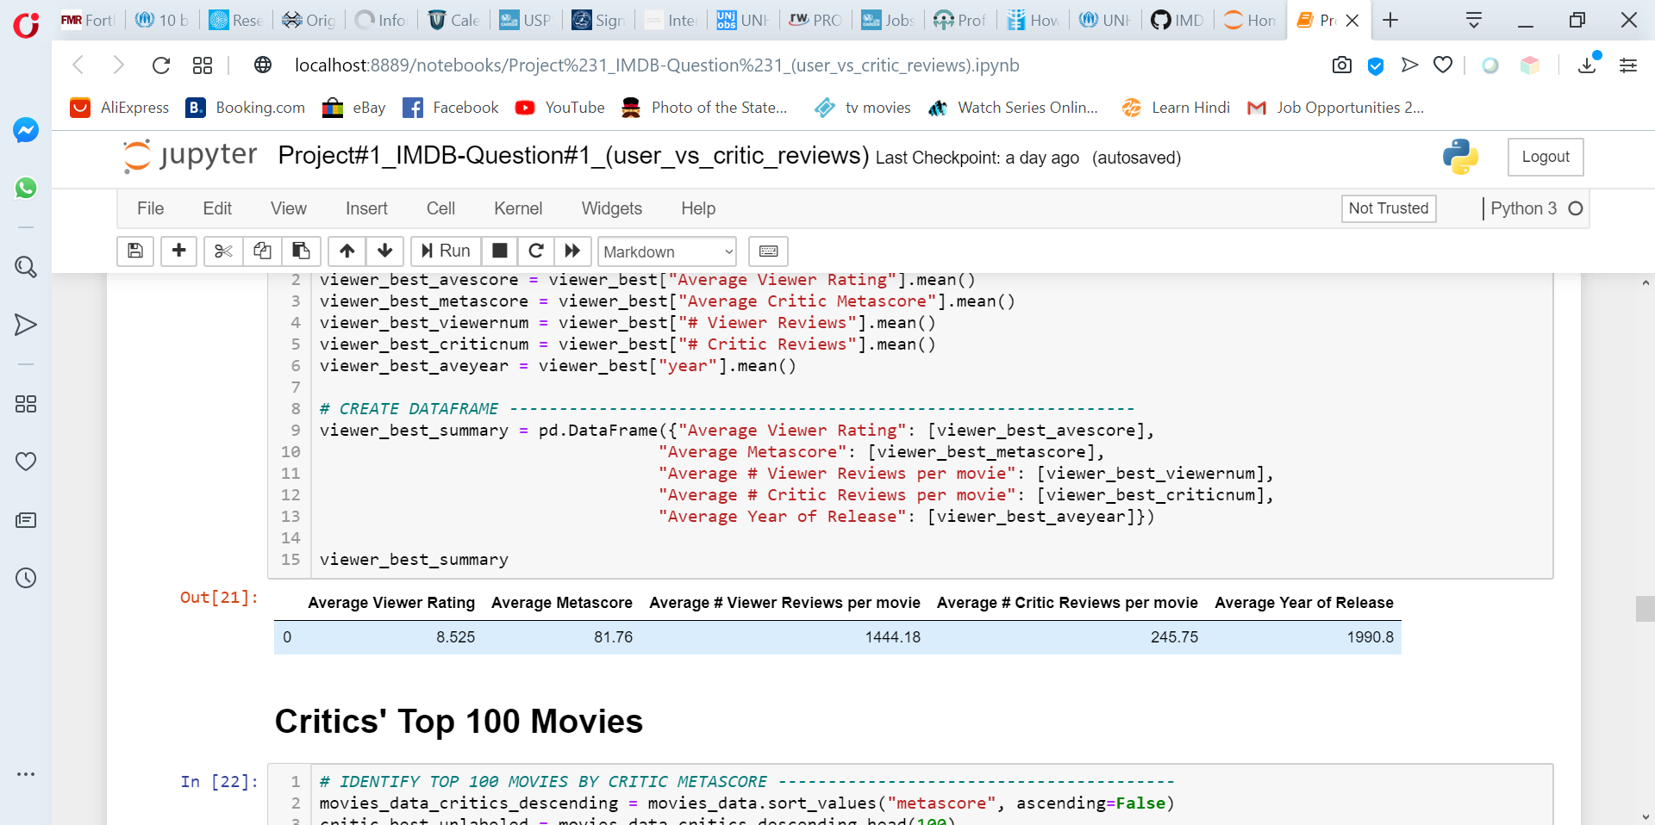
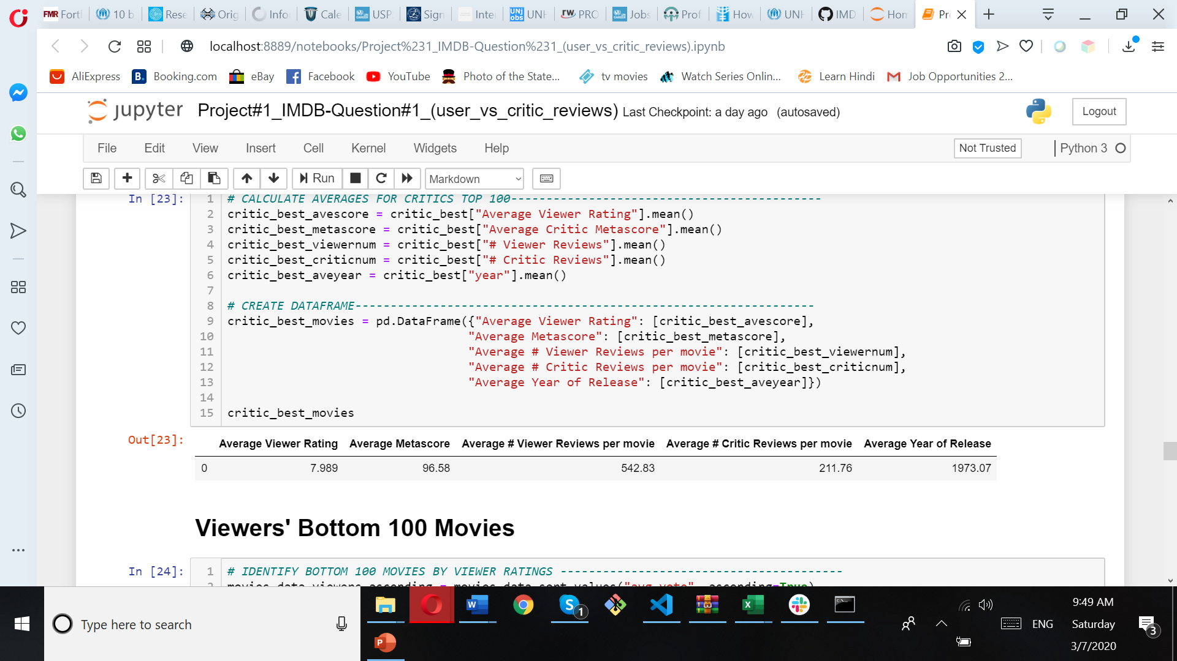
Top Movies
Viewers
Critics
VIEWERS
Viewers
Critics

Slide 18
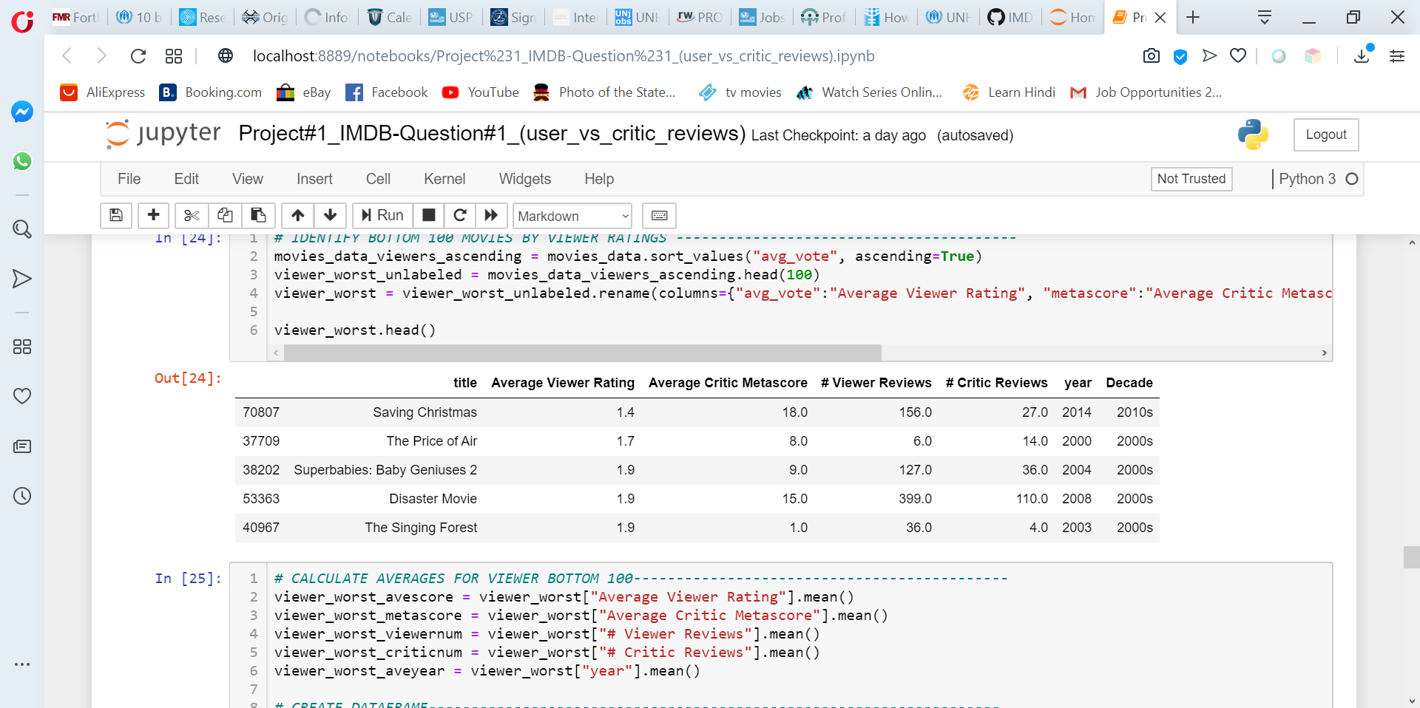
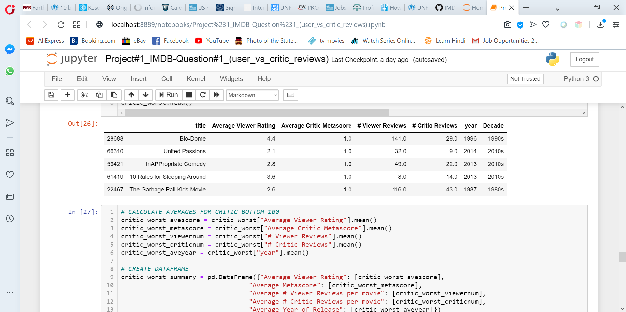
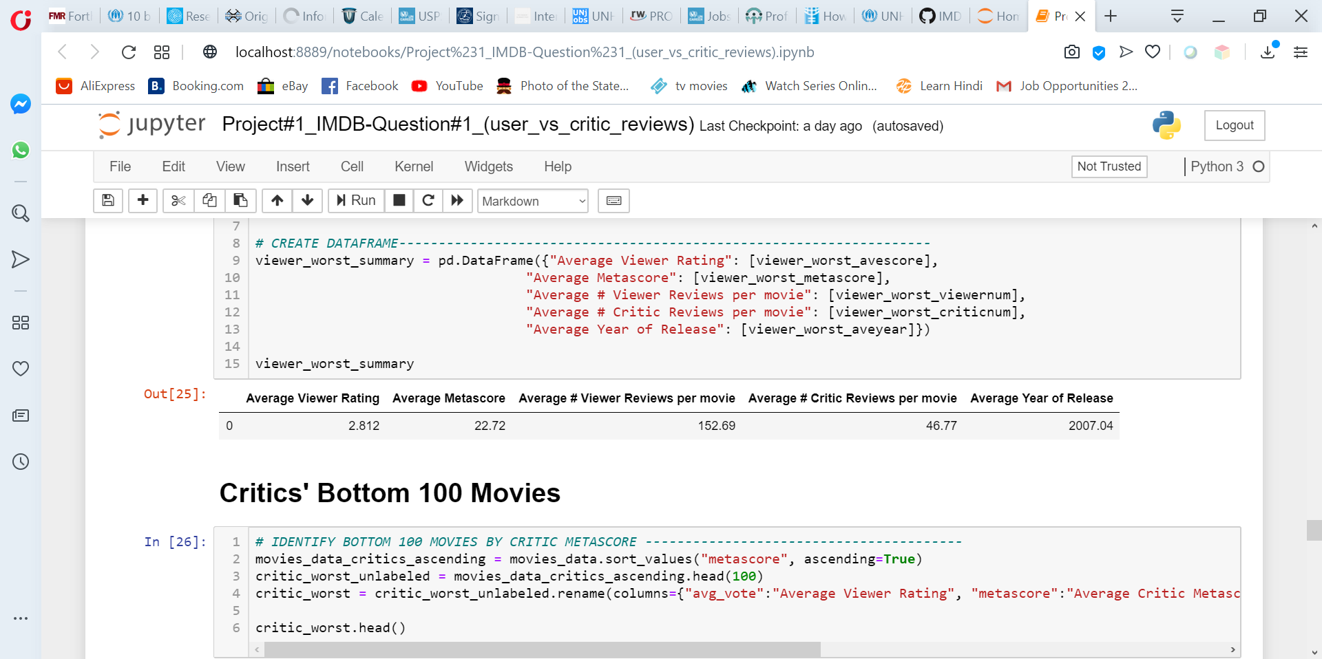
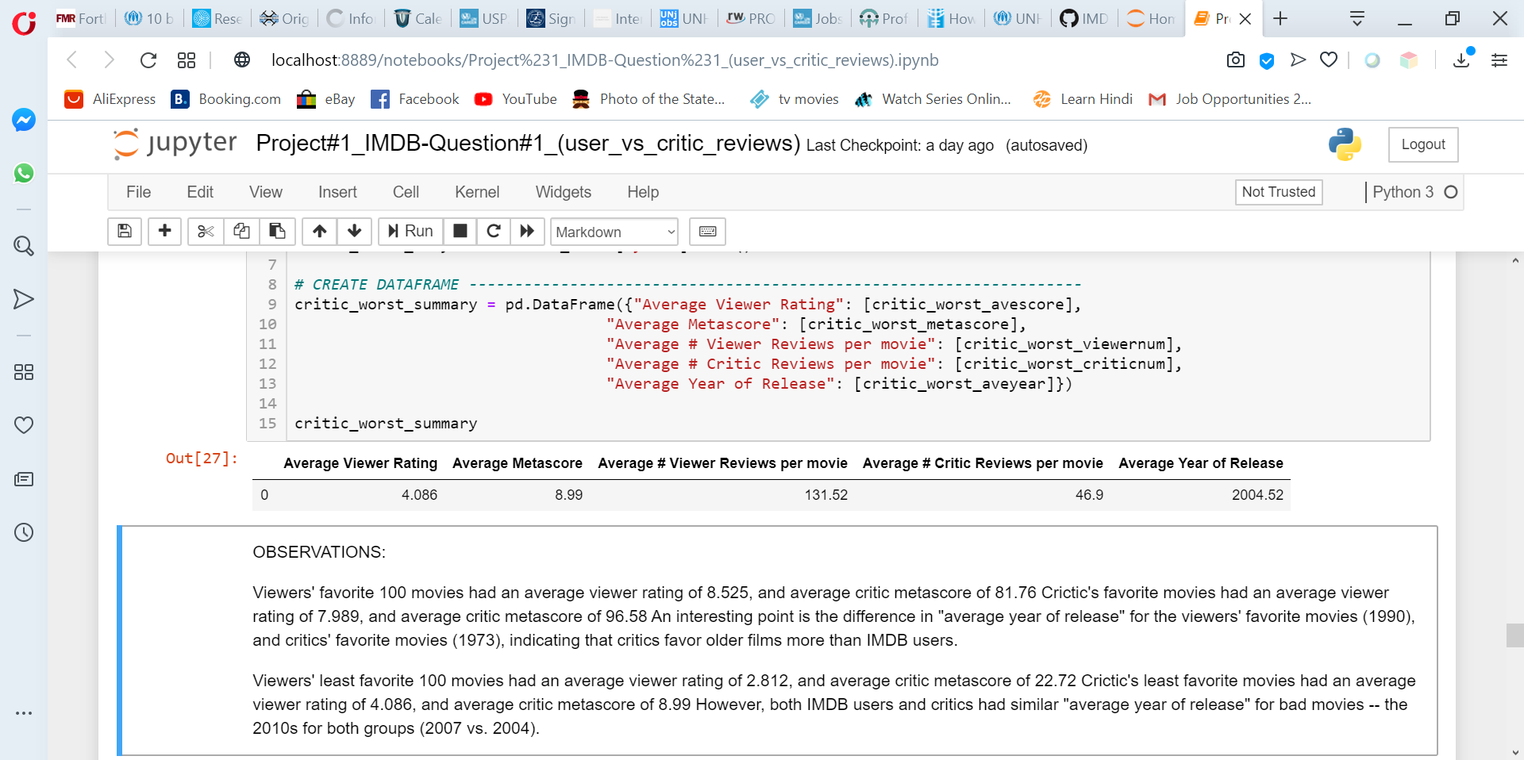
Worst Movies
Viewers
Critics
Viewers
Critics

Slide 19
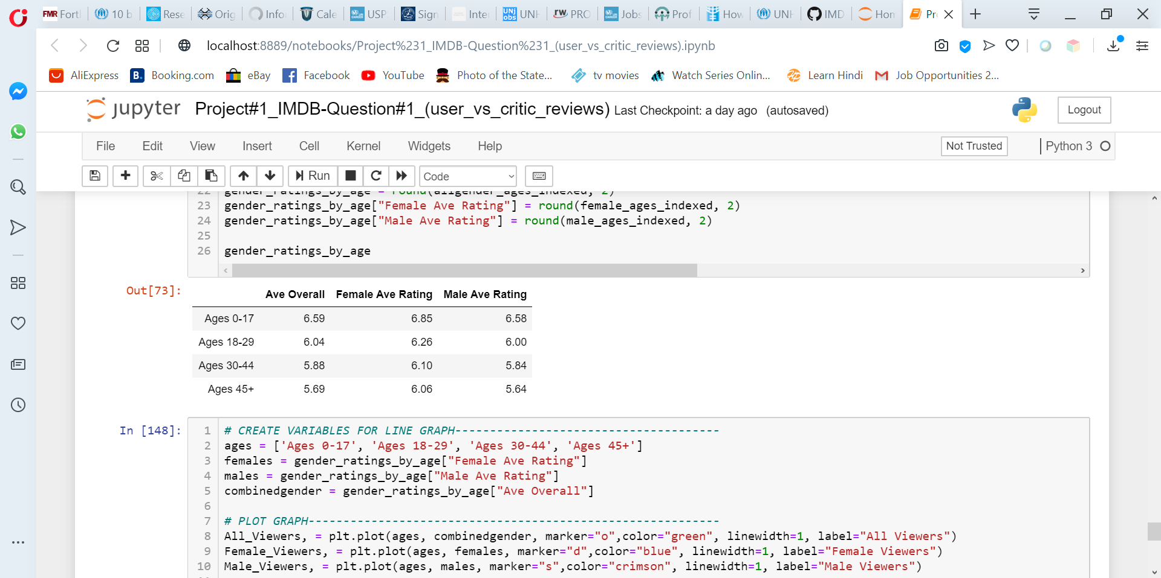
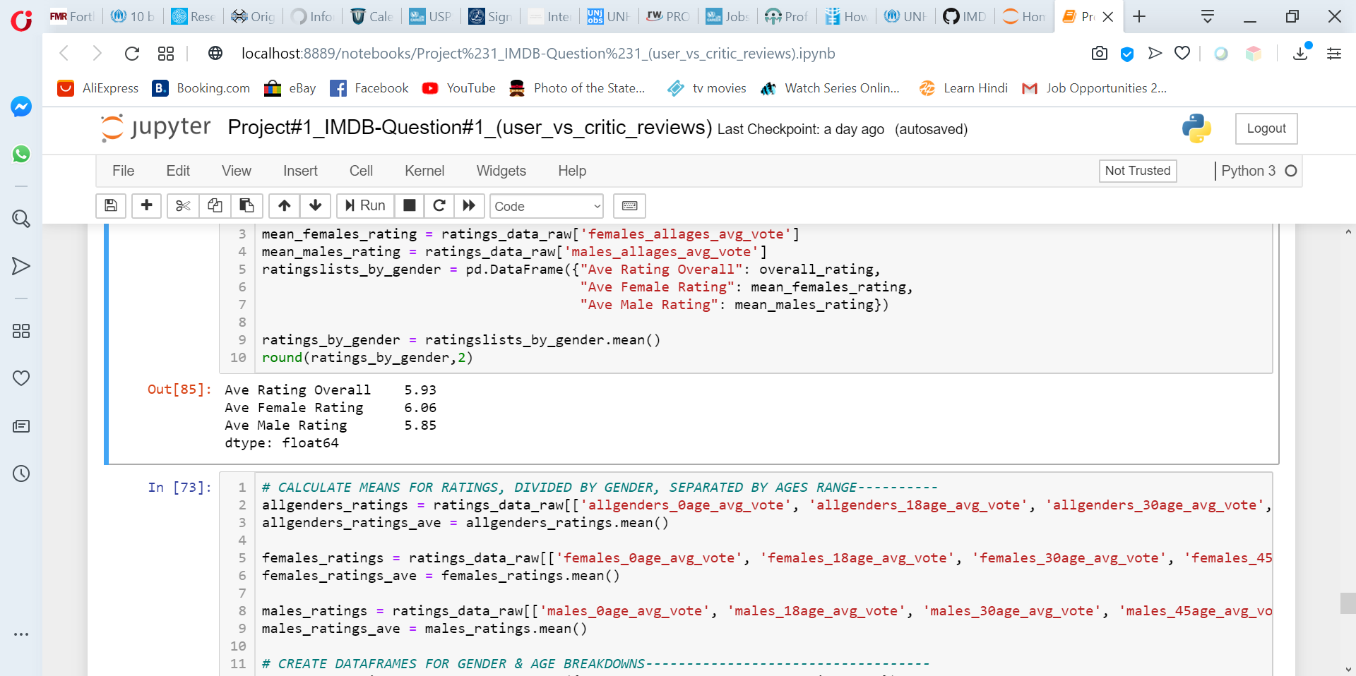
Viewers ratings by Gender

Slide 20
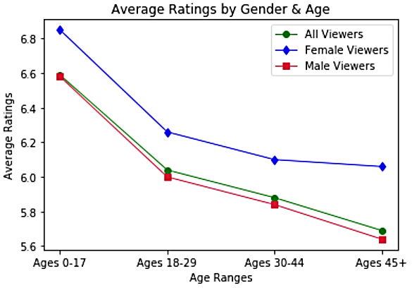

Slide 21
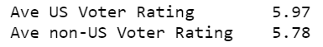
Viewers Ratings: US vs. Non-US
Females viewers rate movies slightly more favorably than male viewers. This trend is consistent across all age ranges when the data are divided by age.
Older viewers (both male and female) consistently give less favorable ratings than viewers younger than them.
Average ratings from US viewers trend slightly higher than for viewers in other countries.

Slide 22

Conclusion
Overall, critics are slight tougher reviewers, but it depends on the movie. Critics and viewers like different types of movies.
Men and non-US viewers are typically harsher critics.

